Slide 1
UK ELECTION EXIT POLL

Slide 2
DESCRIPTION
Leading news channels CNBE who wants to analyze recent elections. This survey was conducted on 1525 voters with 9 variables. For this project, build a model, to predict which party a voter will vote for based on the given information, to create an exit poll that will help in predicting overall win and seats covered by a particular party.

Slide 3
EXPLORATORY DATA ANALYSIS
 | count | mean | std | min | 25% | 50% | 75% | max
age | 1525.0 | 54.18229508196721 | 15.711208571641977 | 24.0 | 41.0 | 53.0 | 67.0 | 93.0
economic.cond.national | 1525.0 | 3.2459016393442623 | 0.8809692844149642 | 1.0 | 3.0 | 3.0 | 4.0 | 5.0
economic.cond.household | 1525.0 | 3.140327868852459 | 0.9299513985782148 | 1.0 | 3.0 | 3.0 | 4.0 | 5.0
Blair | 1525.0 | 3.3344262295081966 | 1.1748241123034677 | 1.0 | 2.0 | 4.0 | 4.0 | 5.0
Hague | 1525.0 | 2.7468852459016393 | 1.2307034736168108 | 1.0 | 2.0 | 2.0 | 4.0 | 5.0
Europe | 1525.0 | 6.728524590163935 | 3.297538370463229 | 1.0 | 4.0 | 6.0 | 10.0 | 11.0
political.knowledge | 1525.0 | 1.5422950819672132 | 1.0833147486432724 | 0.0 | 0.0 | 2.0 | 2.0 | 3.0
There are no null values present in the dataset.

Slide 4
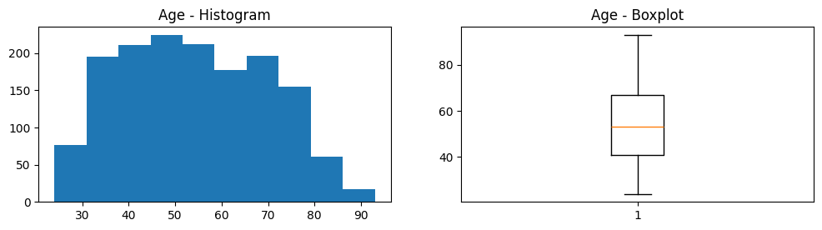
Univariate Analysis - Age
Mean/Std 54.18 +/-15.71
Median: 53
Range: 24 to 93
No outliers
Right skewed

Slide 5
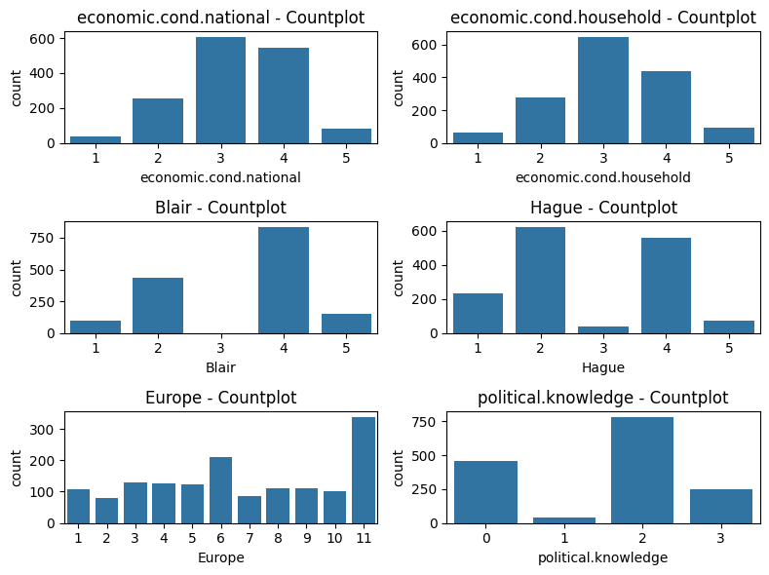
Univariate Analysis - Numeric
Average
economic.cond.national: 3.25; 75% rated 3 or 4
economic.cond.household: 3.14; 71% rated 3 or 4
Blair : 3.33, 64.95% rated as good
Hague: 2.75,43% rated as good. 57% as not good
Europe: 6.73
political.knowledge: 1.54

Slide 6
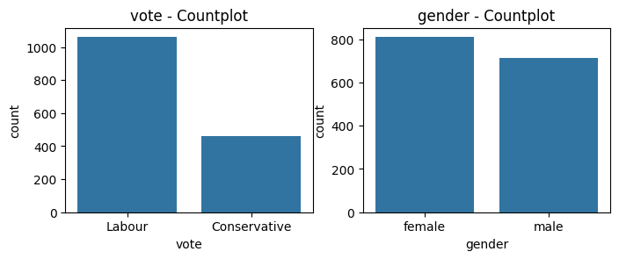
Univariate Analysis - Categorical
Out of 1525 voters, 69.7% voted Labour Party and 30.3 % for Conservative party.
53% Females voters; 47% male voters

Slide 7
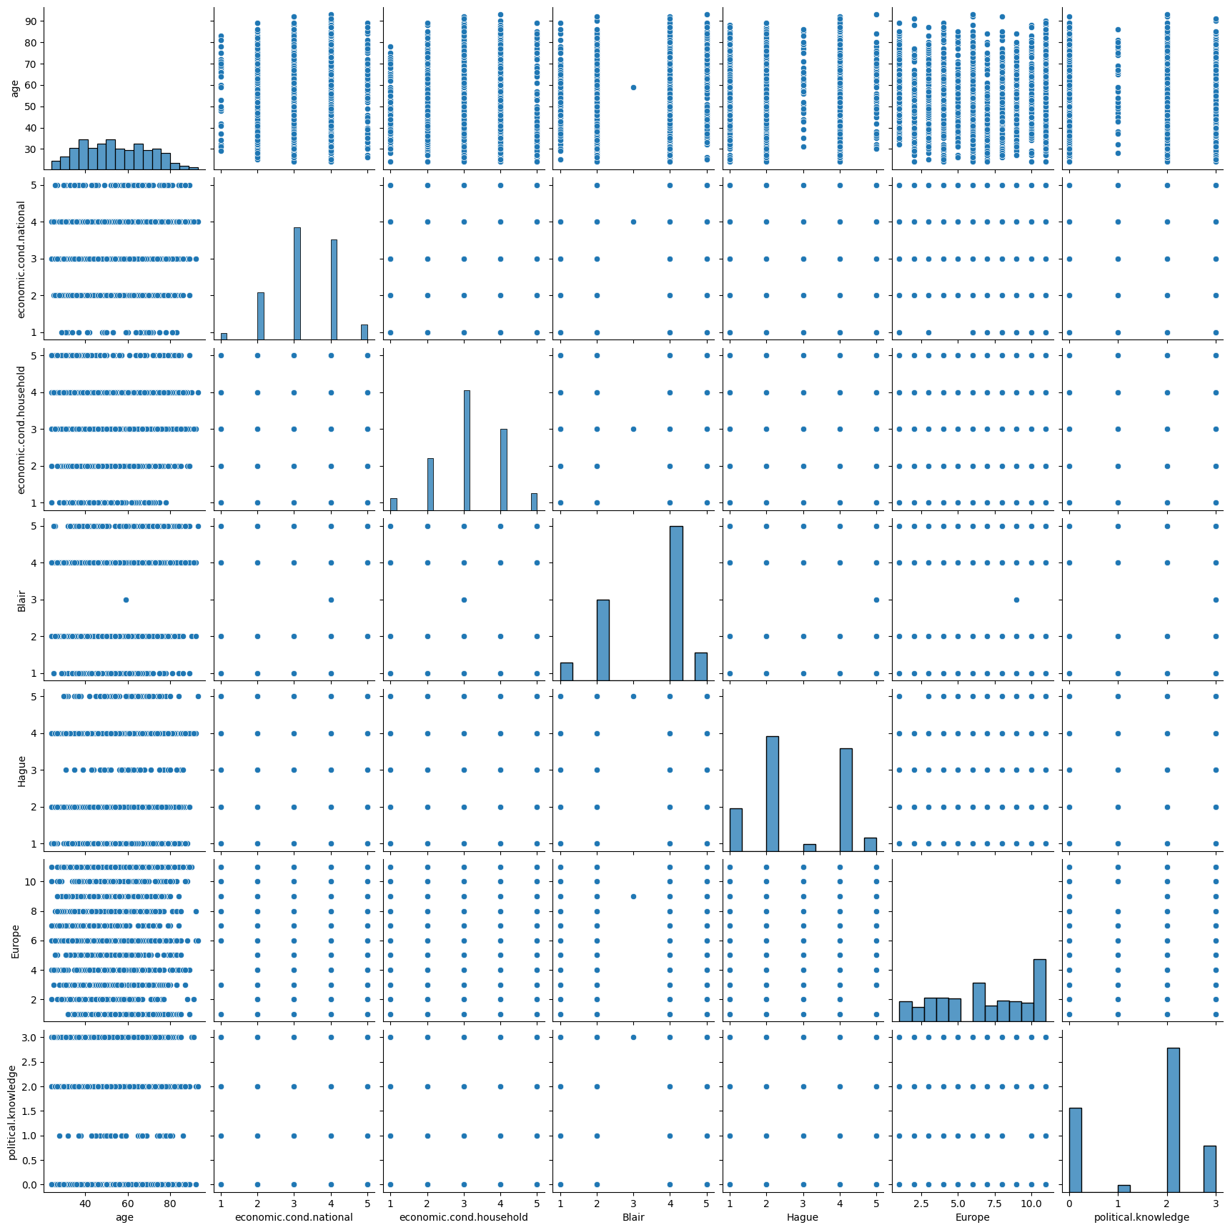
Bivariate Analysis - Categorical
Pair plot shows slight positive correlation between the ratings of economic conditions of the nation & the households.
This slight positive correlation exists with the ratings of labour party leader, Tony Blair as well and

Slide 8
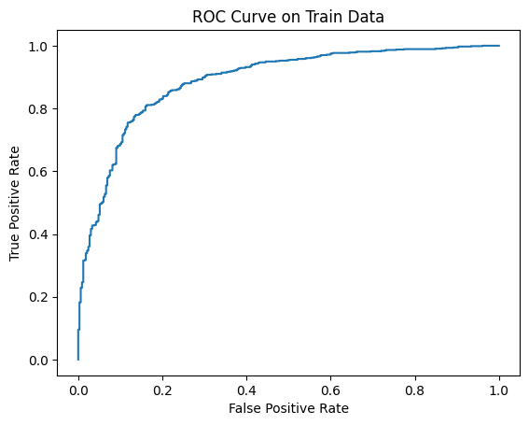
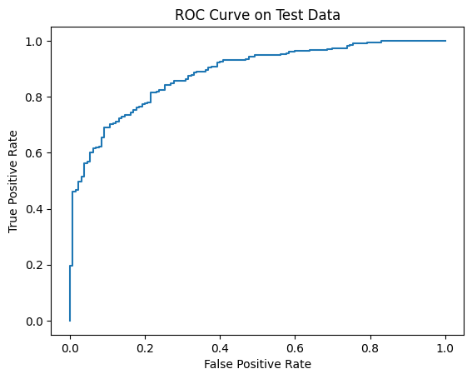
Linear Regression
Accuracy of Train data – 84%
ROC AUC Score of Train data – 89%
Accuracy of Test data – 82%
ROC AUC Score of Test data – 88%

Slide 9
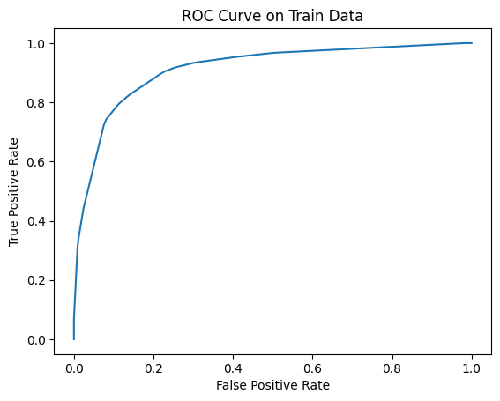
Decision Tree
Accuracy of Train data – 86%
ROC AUC Score of Train data – 91%
Accuracy of Test data – 81%
ROC AUC Score of Test data – 81%

Slide 10
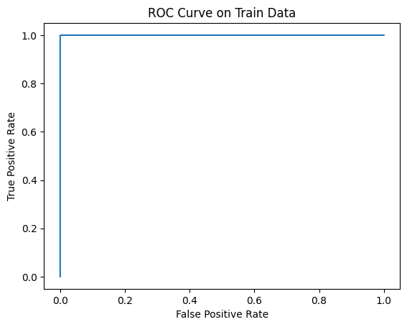
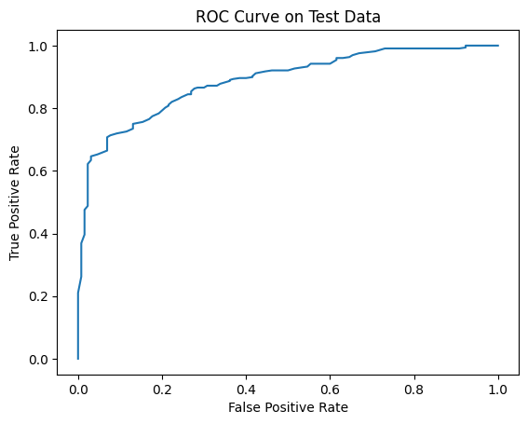
Random Forest
Accuracy of Train data – 99.9%
ROC AUC Score of Train data – 99.9%
Accuracy of Test data – 82
ROC AUC Score of Test data – 88%

Slide 11
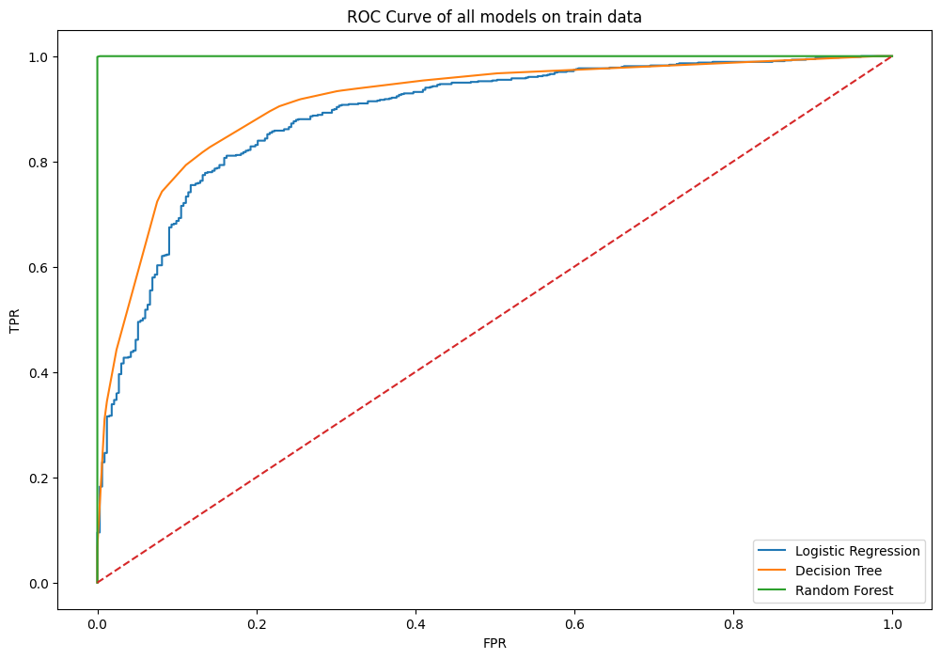
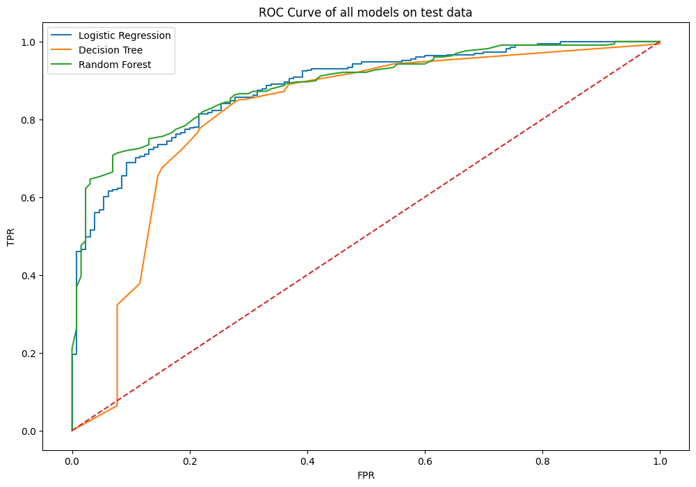
ROC Curve for all models

Slide 12
Summary
Random Forest has the highest accuracy score of 82%. This means it correctly classifies 82% of the data points.
Based on both accuracy and AUC, Random Forest is the most promising model in this case.
From prediction of Random Forest model, Labour is getting more votes than Conservative. So, Labour will win the election

